Slide 1
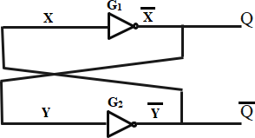
Copyright © The McGraw-Hill Companies, Inc. Permission required for reproduction or display.
Basic bistable element.
Figure 6.1
6-<number>

Slide 2
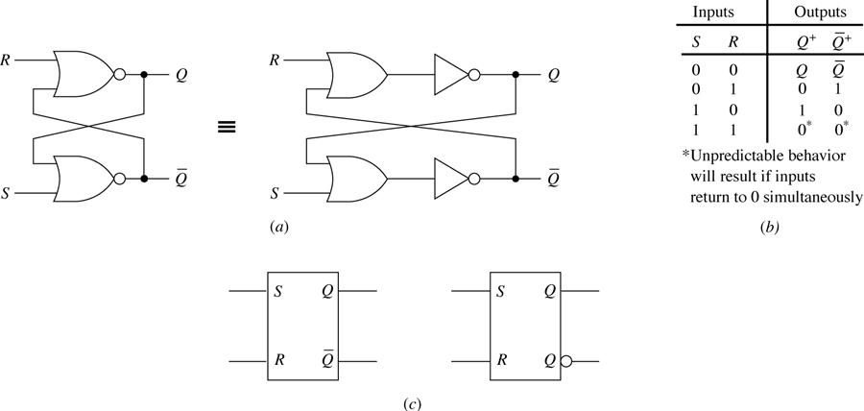
SR latch. (a) Logic diagrams. (b) Function table where Q⁺ denotes the output Q in response to the inputs.
(c) Two logic symbols.
Figure 6.2

Slide 3
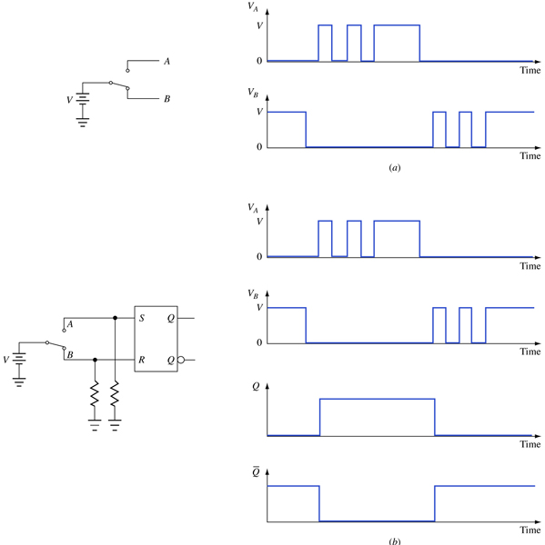
An application of the SR latch. (a) Effects of contact bounce. (b) A switch debouncer.
Figure 6.3

Slide 4

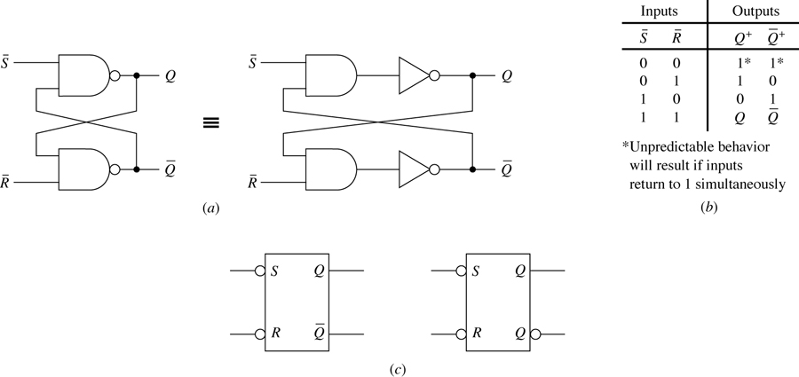
latch. (a) Logic diagrams. (b) Function table where Q⁺ denotes the output Q in response to the inputs.
(c) Two logic symbols.
Figure 6.4

Slide 5
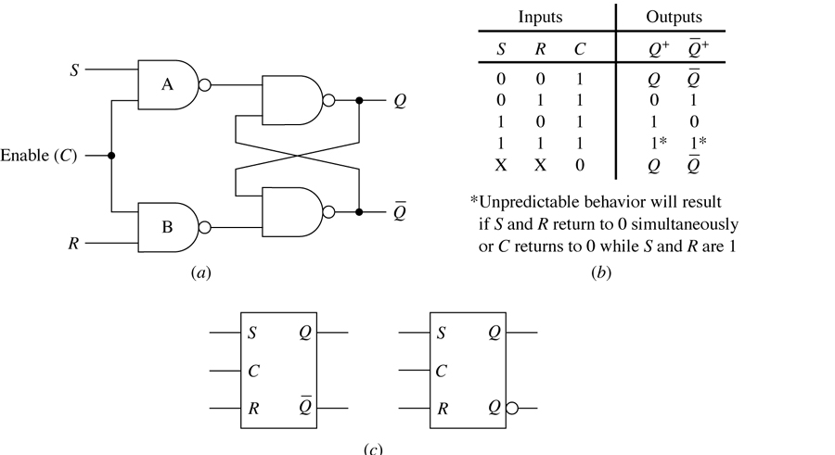
Gated SR latch. (a) Logic diagram. (b) Function table where Q⁺ denotes the output Q in response to the inputs. (c) Two logic symbols.
Figure 6.5
(c)

Slide 6
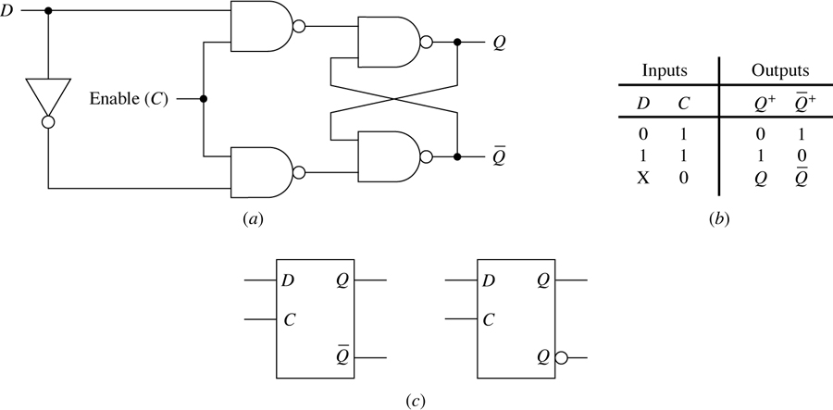
Gated D latch. (a) Logic diagram. (b) Function table where Q⁺ denotes the output Q in response to the inputs. (c) Two logic symbols.
Figure 6.6

Slide 7
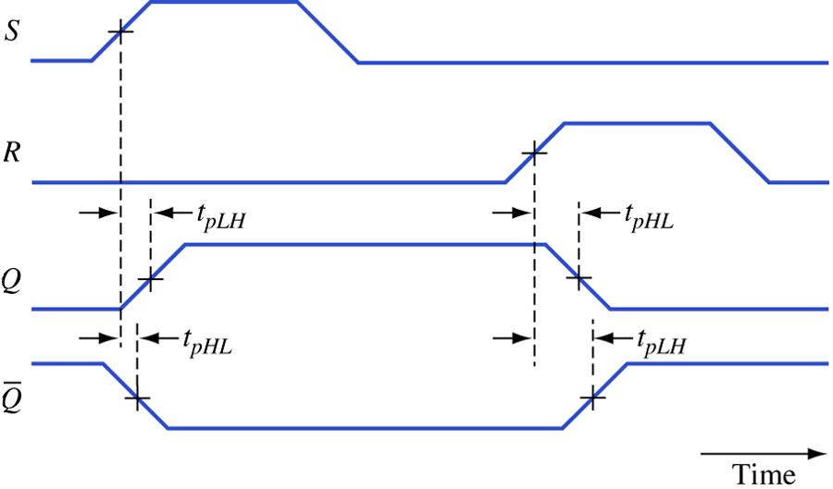
Propagation delays in an SR latch.
Figure 6.7

Slide 8
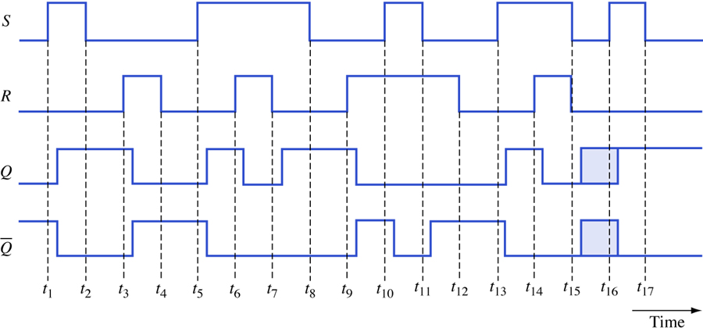
Timing diagram for an SR latch.
Figure 6.8

Slide 9
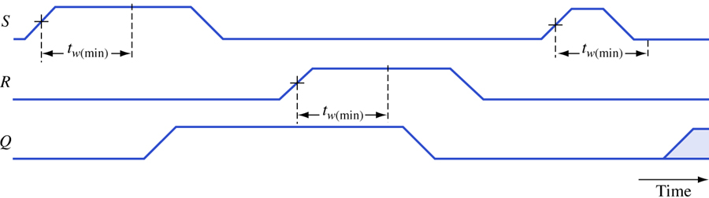
Minimum pulse width constraint.
Figure 6.9

Slide 10
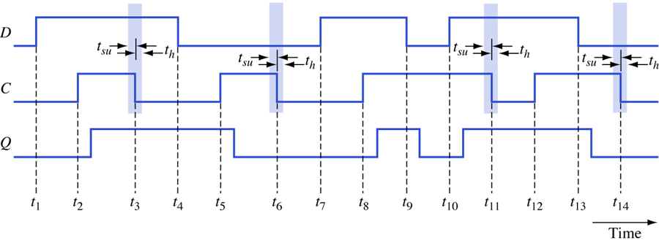
Timing diagram for a gated D latch.
Figure 6.10

Slide 11
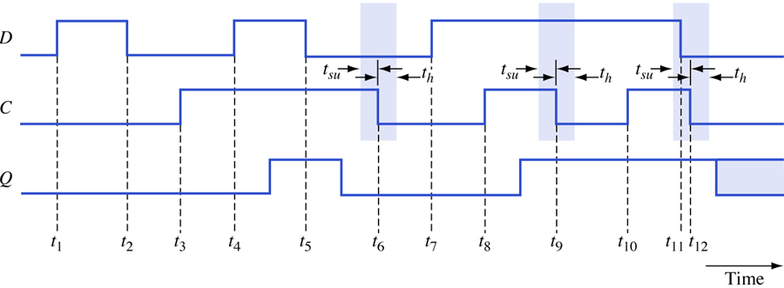
Illustration of an unpredictable response in a gated D latch.
Figure 6.11

Slide 12
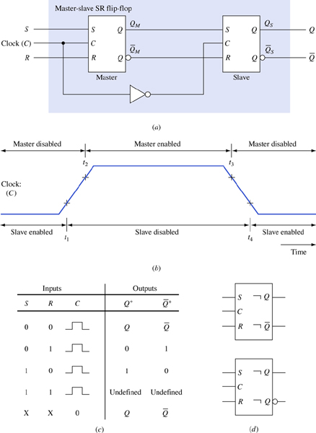
Master-slave SR flip-flop. (a) Logic diagram using gated SR latches. (b) Flip-flop action during the control signal.
(c) Function table where Q⁺ denotes the output Q in response to the inputs. (c) Two logic symbols.
Figure 6.12

Slide 13
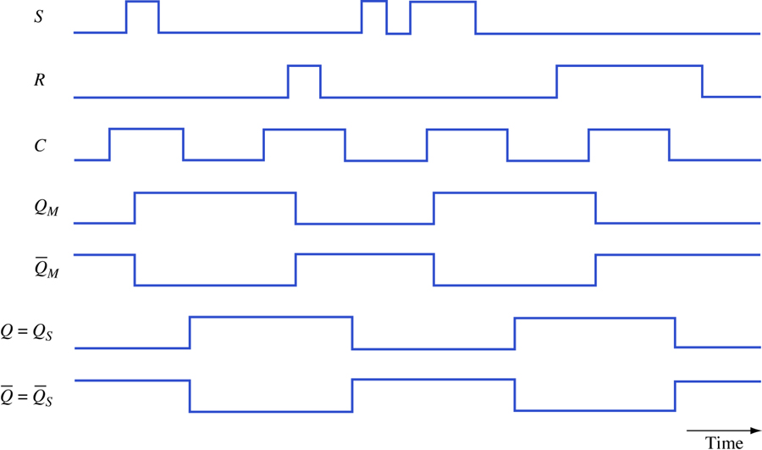
Timing diagram for a master-slave SR flip-flop.
Figure 6.13

Slide 14
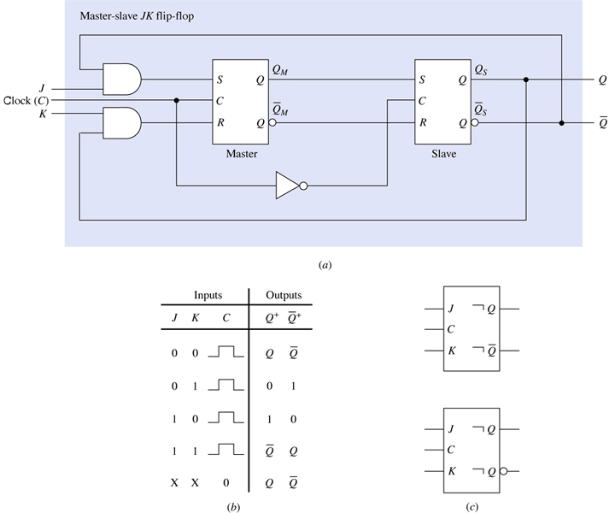
Master-slave JK flip-flop. (a) Logic diagram using gated SR latches. (b) Function table where Q⁺ denotes the output Q in response to the inputs. (c) Two logic symbols.
Figure 6.14

Slide 15
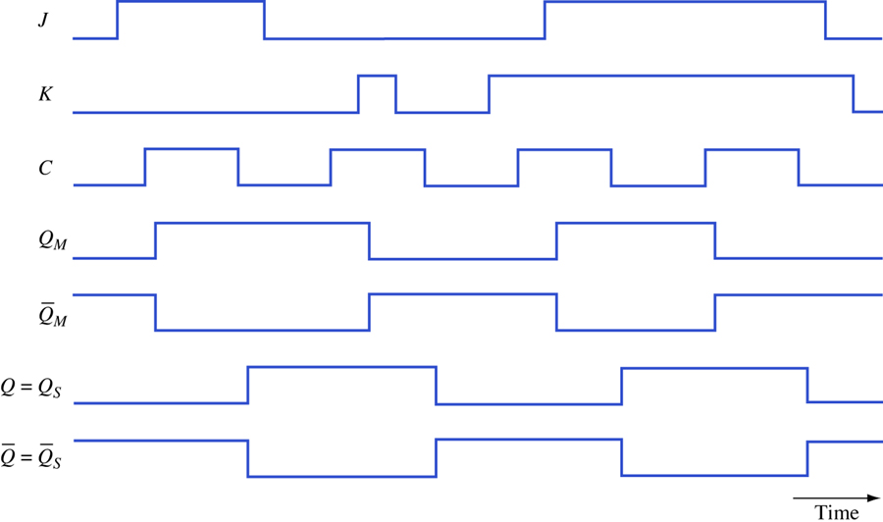
Timing diagram for master-slave JK flip-flop.
Figure 6.15

Slide 16
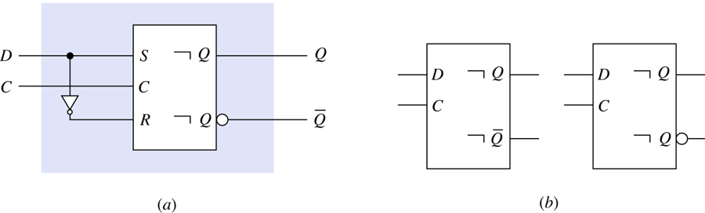
Master-slave D flip-flop. (a) Logic diagram using master-slave SR flip-flop (b) Two logic symbols.
Figure 6.16

Slide 17
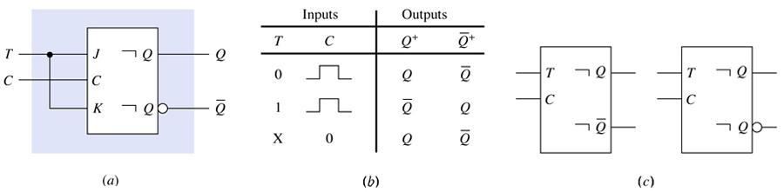
Master-slave T flip-flop. (a) Logic diagram using a master-slave JK flip-flop. (b) Function table where Q⁺ denotes the output Q in response to the inputs. (c) Two logic symbols.
Figure 6.17

Slide 18
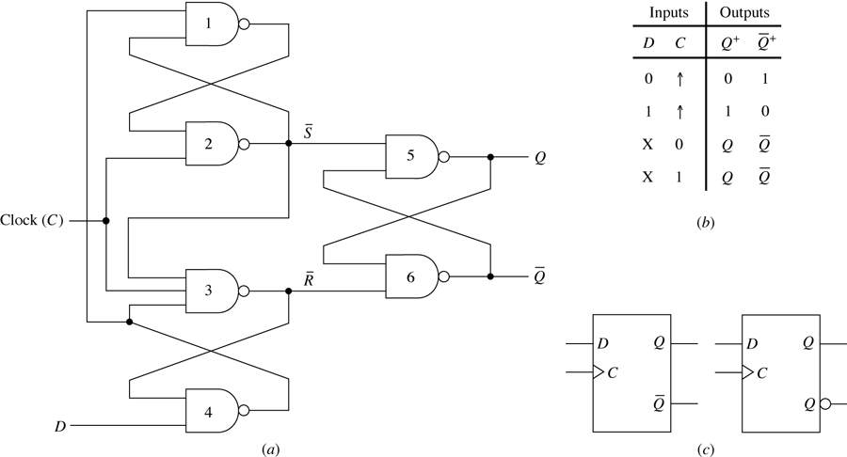
Positive-edge-triggered D flip-flop. (a) Logic diagram.
(b) Function table where Q⁺ denotes the output Q in response to the inputs. (c) Two logic symbols.
Figure 6.18

Slide 19
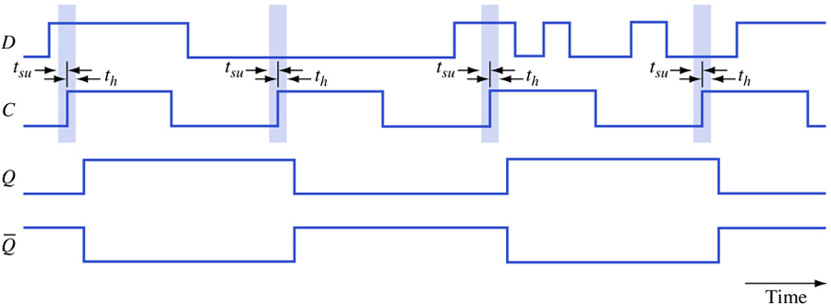
Timing diagram for a positive-edge-triggered D flip-flop.
Figure 6.19

Slide 20
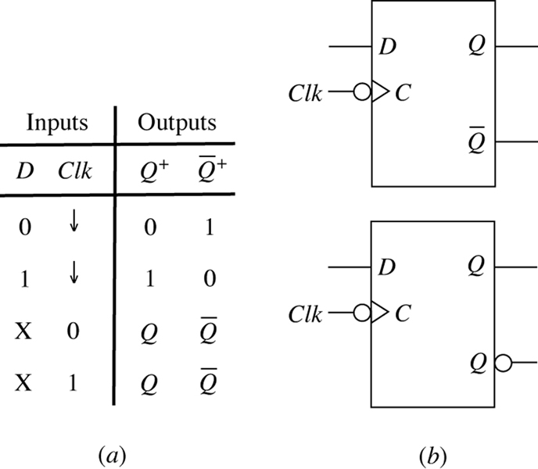
Negative-edge-triggered D flip-flop. (a) Function table where Q⁺ denotes the output Q in response to the inputs. (b) Two logic symbols.
Figure 6.20

Slide 21
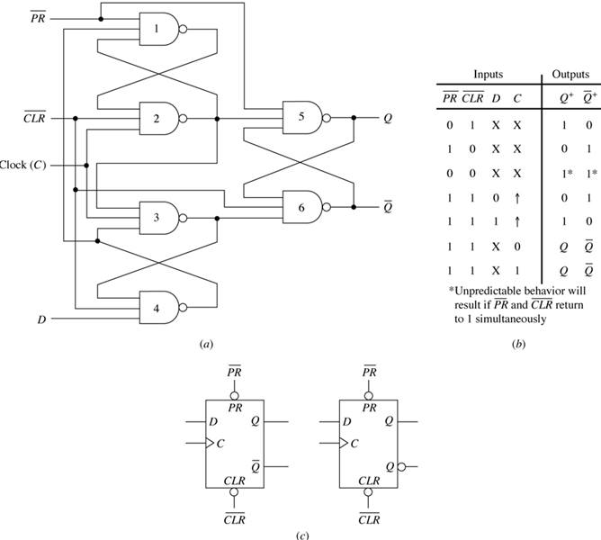
Positive-edge-triggered D flip-flop with asynchronous inputs. (a) Logic diagram. (b) Function table where Q⁺ denotes the output Q in response to the inputs. (c) Two logic symbols.
Figure 6.21

Slide 22
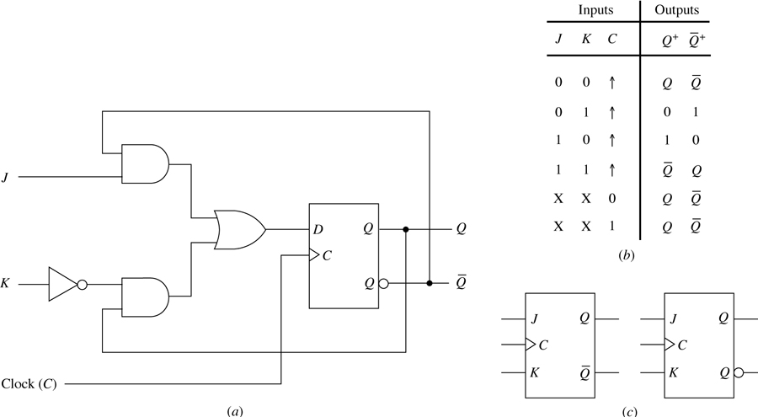
Positive-edge-triggered JK flip-flop. (a) Logic diagram.
(b) Function table where Q⁺ denotes the output Q in response to the inputs. (c) Two logic symbols.
Figure 6.22

Slide 23
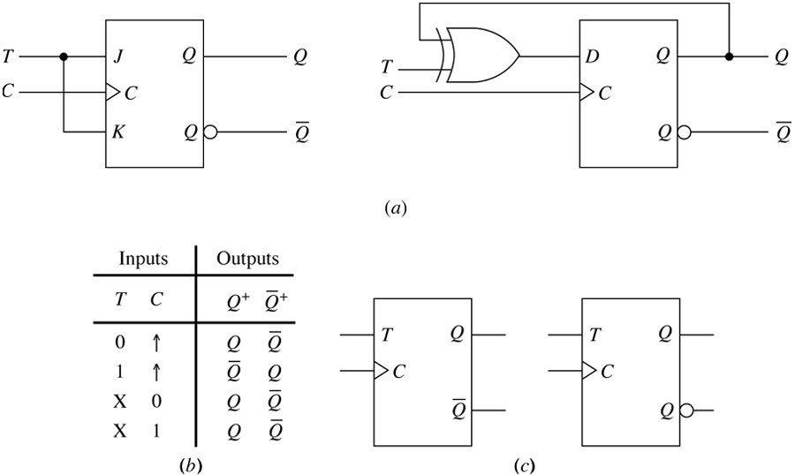
Positive-edge-triggered T flip-flop. (a) Logic diagram.
(b) Function table where Q⁺ denotes the output Q in response to the inputs. (c) Two logic symbols.
Figure 6.23

Slide 24
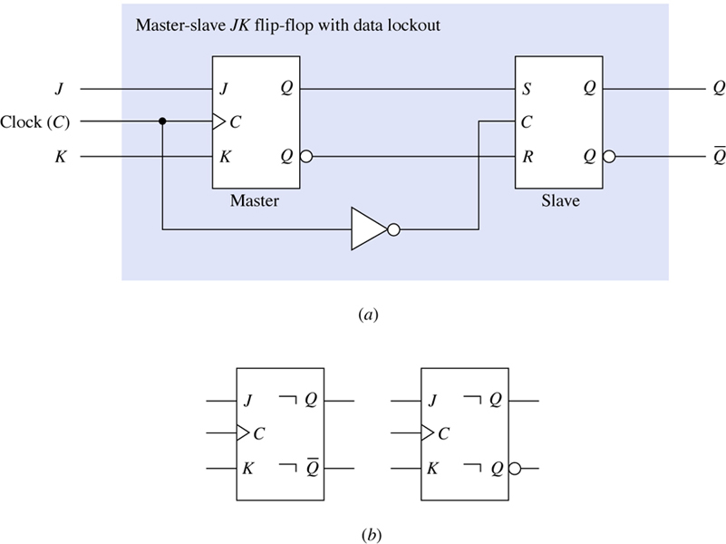
Master-slave JK flip-flop with data lockout. (a) Logic diagram. (b) Two logic symbols.
Figure 6.24

Slide 25
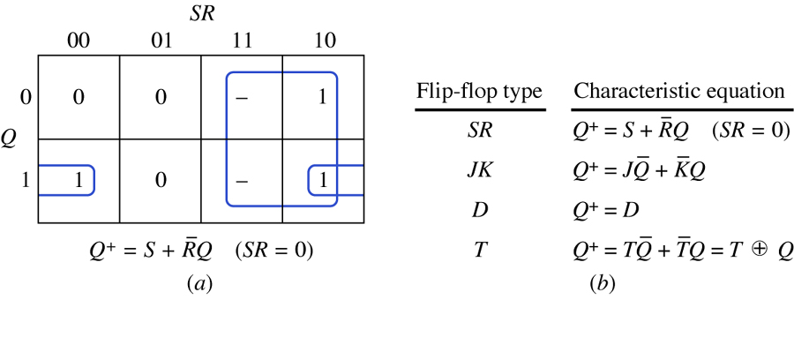
Characteristic equations. (a) Derivation of characteristic equation for an SR flip-flop. (b) Summary of characteristic equations.
Figure 6.25

Slide 26
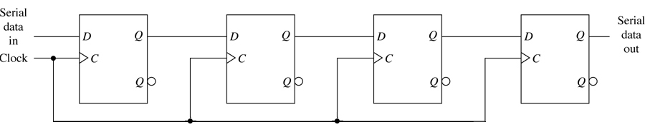
Serial-in, serial-out unidirectional shift register.
Figure 6.26

Slide 27
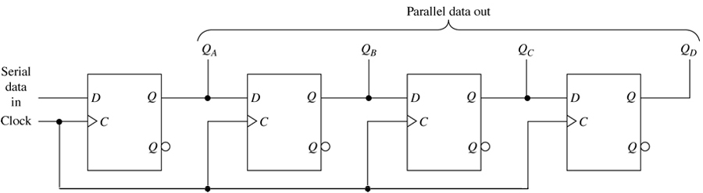
Serial-in, parallel-out unidirectional shift register.
Figure 6.27

Slide 28
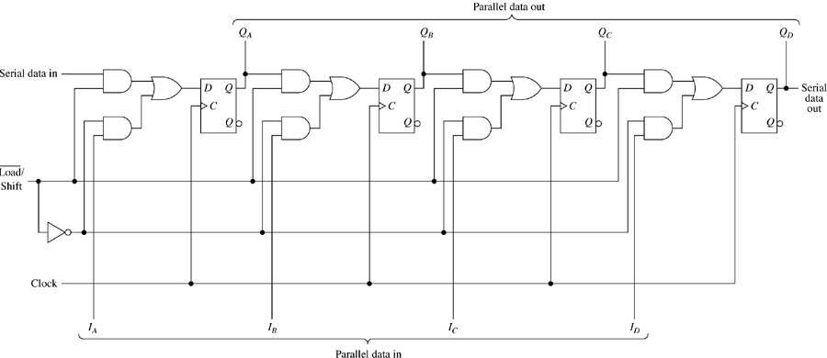
Parallel-in unidirectional shift register.
Figure 6.28

Slide 29
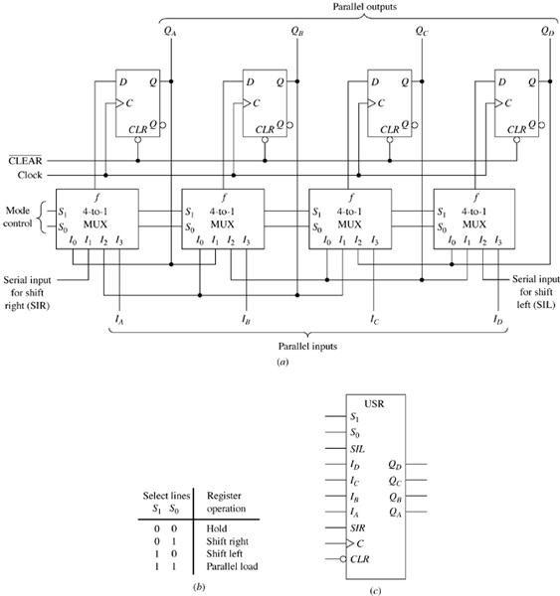
Universal shift register. (a) Logic diagram. (b) Mode control.
(c) Symbol.
Figure 6.29

Slide 30
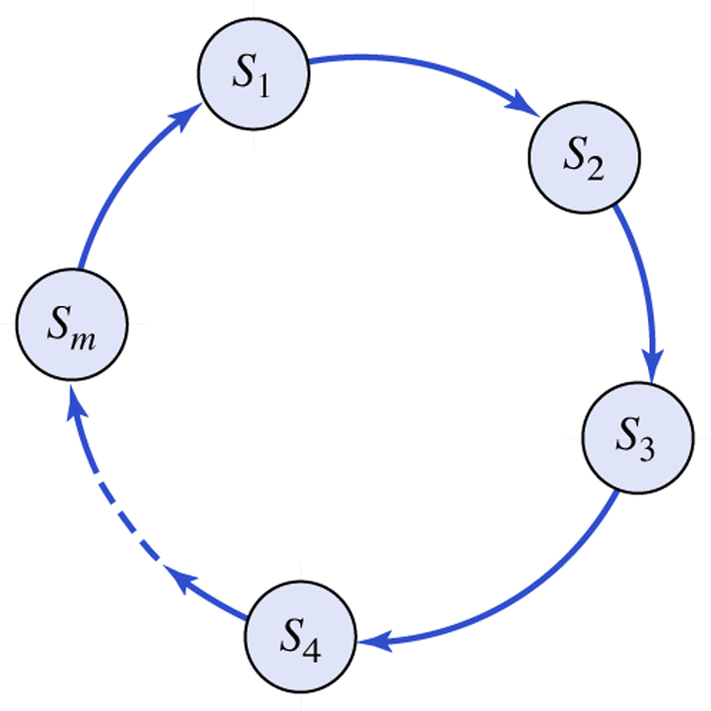
State diagram of a counter.
Figure 6.30

Slide 31
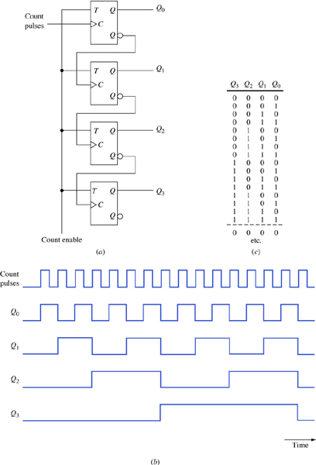
Four-bit binary ripple counter. (a) Logic diagram. (b) Timing diagram. (c) Counting sequence.
Figure 6.31

Slide 32
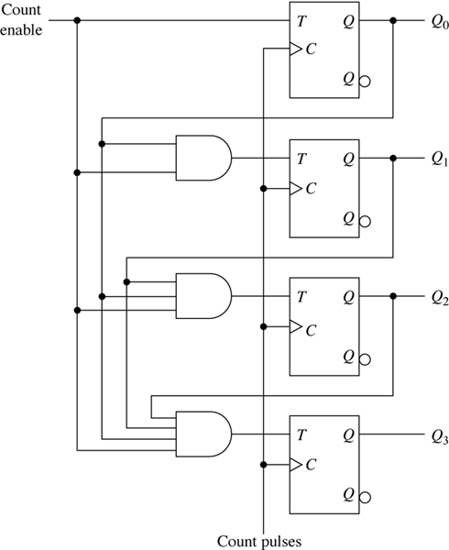
Four-bit synchronous binary counter.
Figure 6.32

Slide 33
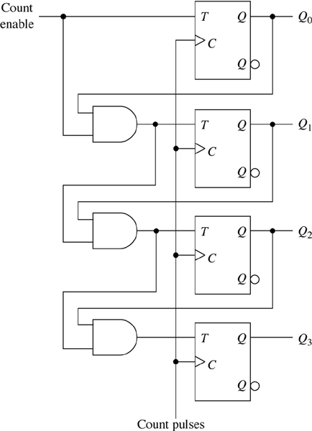
Four-bit synchronous binary counter variation.
Figure 6.33

Slide 34
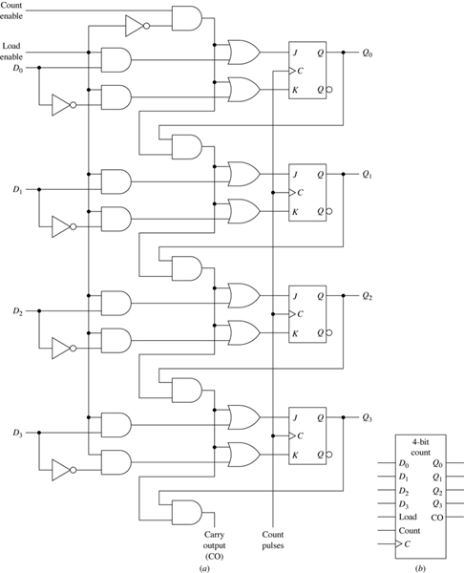
Four-bit synchronous binary counter with parallel load inputs. (a) Logic diagram. (b) Symbol.
Figure 6.34

Slide 35
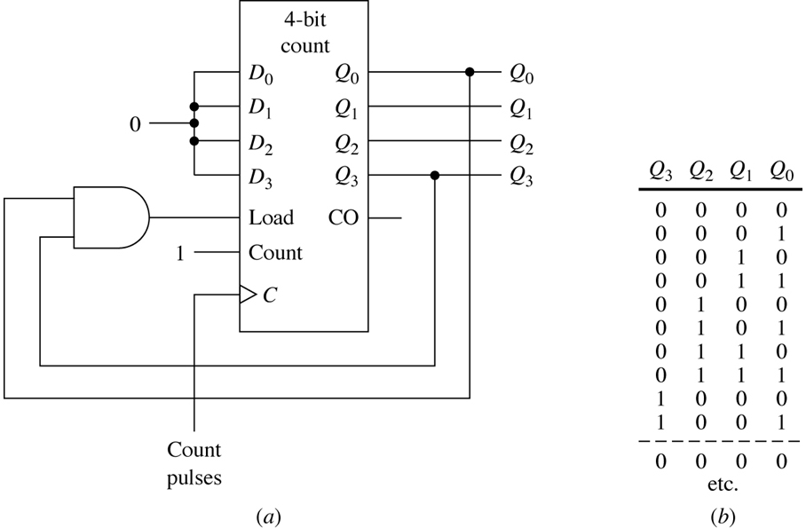
Synchronous mod-10 counter. (a) Connections. (b) Counting sequence.
Figure 6.35

Slide 36
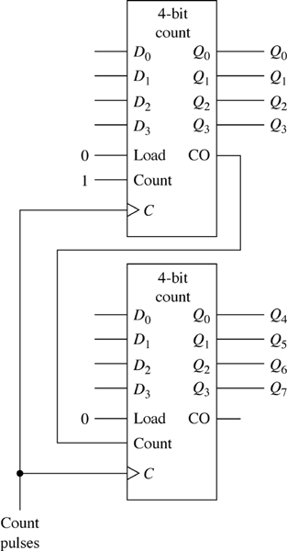
8-bit synchronous binary counter constructed from two 4-bit synchronous binary counters.
Figure 6.36

Slide 37
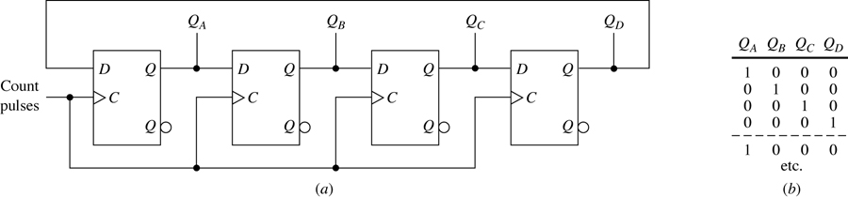
Mod-4 ring counter. (a) Logic diagram. (b) Counting sequence.
Figure 6.37

Slide 38
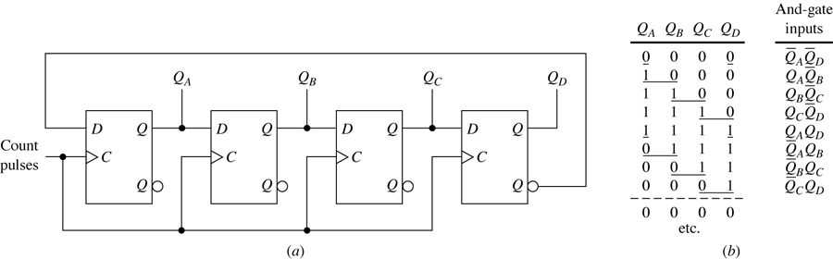
Mod-8 twisted-ring counter. (a) Logic diagram. (b) Counting sequence.
Figure 6.38

Slide 39
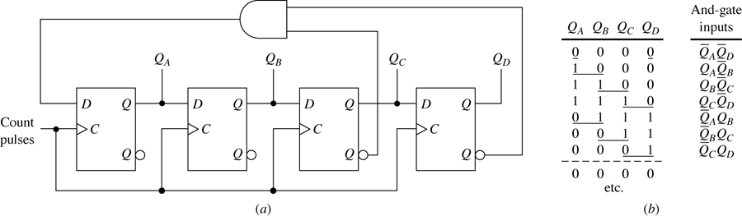
Mod-7 twisted-ring counter. (a) Logic diagram. (b) Counting sequence.
Figure 6.39

Slide 40
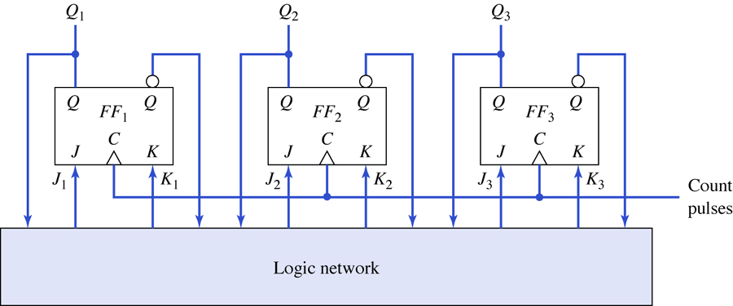
General structure of a synchronous mod-6 counter using positive-edge-triggered JK flip-flops.
Figure 6.40

Slide 41
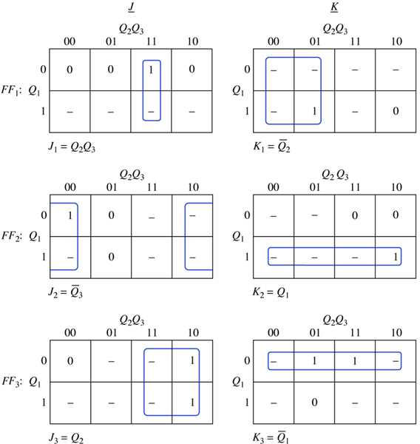
Determination of the minimal-sum expressions for a synchronous mod-6 counter using clocked JK flip-flops.
Figure 6.41

Slide 42
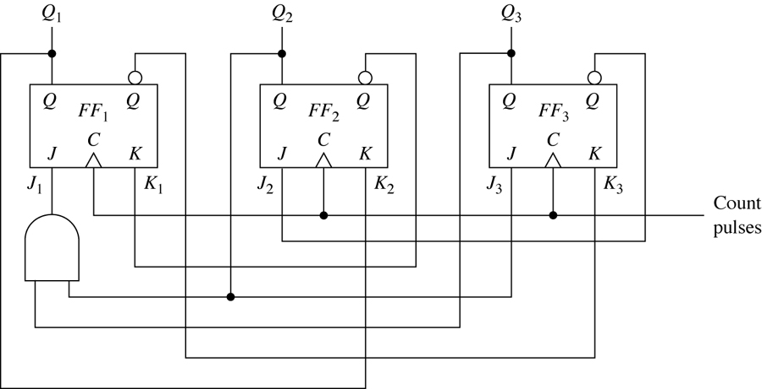
Logic diagram of a synchronous mod-6 counter.
Figure 6.42

Slide 43
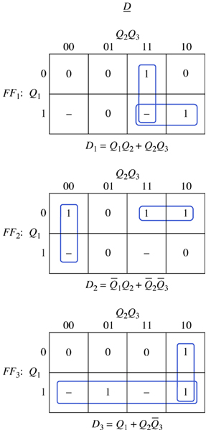
Determination of the minimal-sum expressions for a synchronous mod-6 counter using clocked D flip-flops.
Figure 6.43

Slide 44
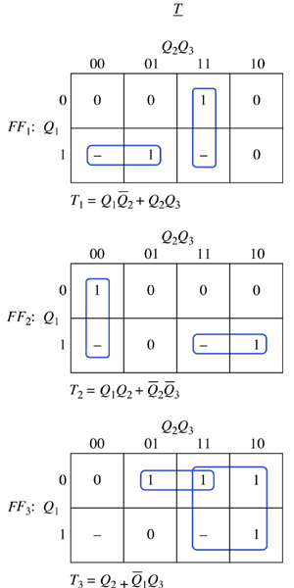
Determination of the minimal-sum expressions for a synchronous mod-6 counter using clocked T flip-flops.
Figure 6.44

Slide 45
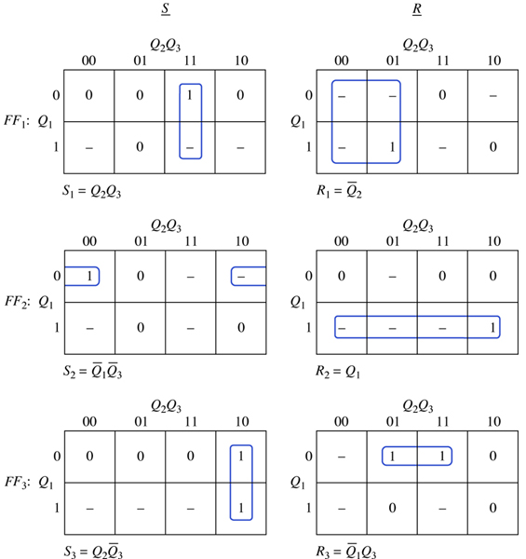
Determination of the minimal-sum expressions for a synchronous mod-6 counter using clocked SR flip-flops.
Figure 6.45

Slide 46
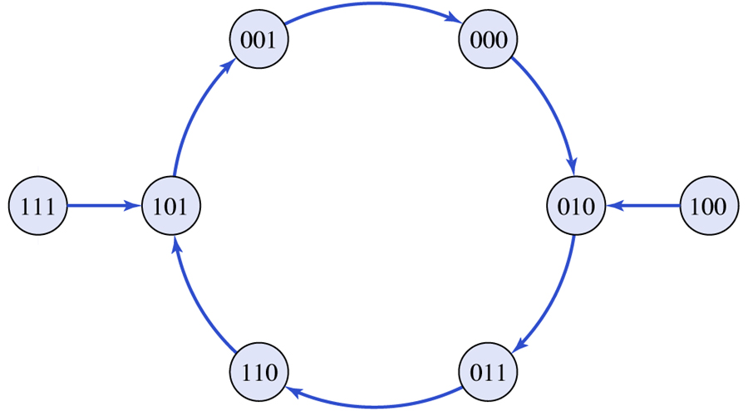
Complete state diagram for the synchronous mod-6 counter of Fig. 6.42.
Figure 6.46

